Slide 1

VIRTUAL ART GALLERY – PROJECT PRESENTATION
By Sheethal A
Batch 1

Slide 2
INTRODUCTION
Virtual Art Gallery backend project.
Built with Python and MySQL.
Manages artworks, galleries, artists, users, and favorites.
Clean modular structure with multiple folders.
Command-line interface for easy use.

Slide 3
BUSINESS LOGIC
In the modern world, art is no longer limited to physical galleries. With the rise of digital platforms, virtual art spaces have become a powerful way to make artwork accessible to a global audience.
1.Artists can contribute their creations to the gallery.
2. Users can browse the artwork collection and save pieces to their personal favorites.
3. Administrators can manage artworks — adding new pieces, editing existing ones, or removing outdated entries.
4. The system also supports advanced search features, allowing users to quickly discover art based on titles or descriptions.

Slide 4

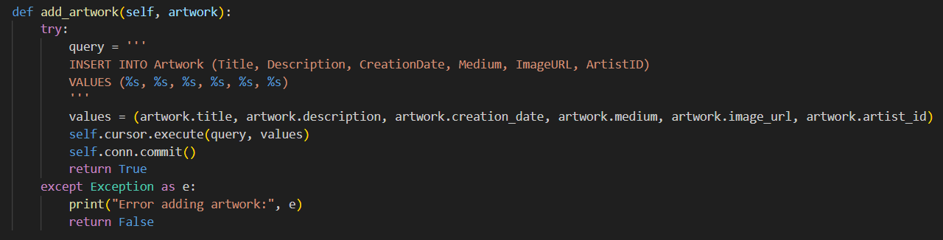
ADD ARTWORK FUNCTION
Adds new artwork to the database.
Takes details like title, description, date, medium, image, artist ID.
Runs an SQL INSERT query.
Confirms successful addition.

Slide 5
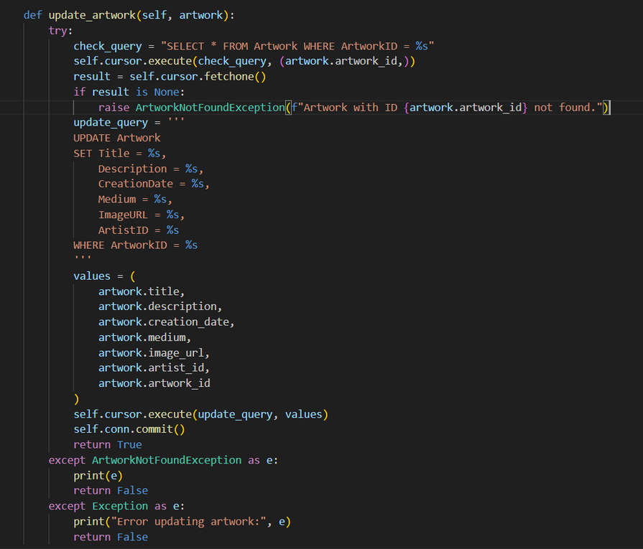
UPDATE ARTWORK
Edits existing artwork details.
Takes artwork ID to identify record.
Runs an SQL UPDATE query.
Confirms successful update.

Slide 6
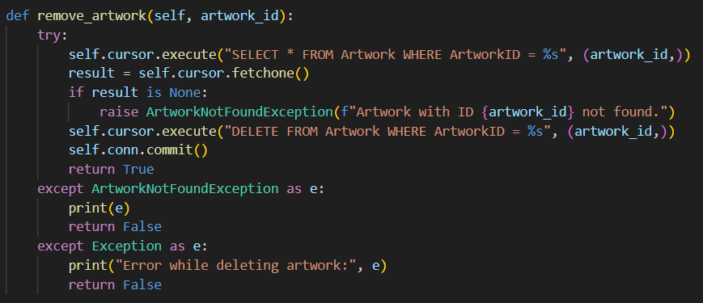
REMOVE ARTWORK FUNCTION
Deletes artwork by ID.
Runs SQL DELETE query.
Cleans up unnecessary records.
Confirms successful removal.

Slide 7
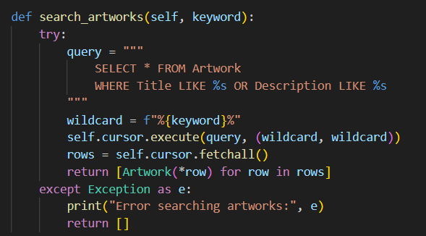
SEARCH ARTWORKS FUNCTION
Allows keyword search.
Matches title or description.
Uses SQL LIKE operator.
Returns matching
artworks.

Slide 8
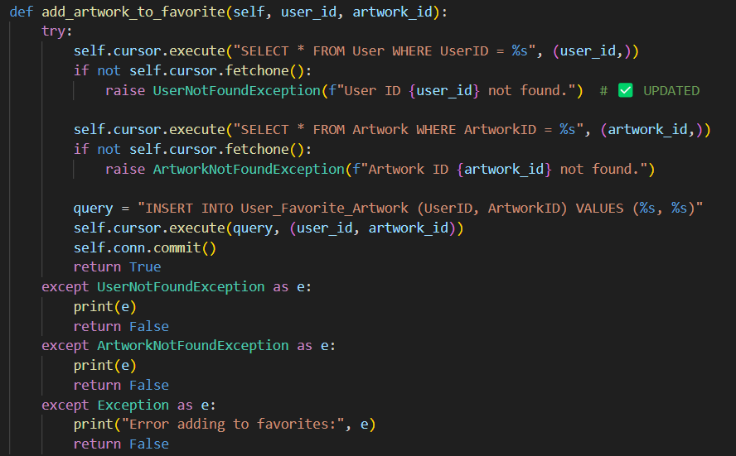
ADD ARTWORK TO FAVORITES
Adds artwork to user's favorites.
Uses UserID and ArtworkID.
Runs SQL INSERT into junction table.
Confirms addition.

Slide 9
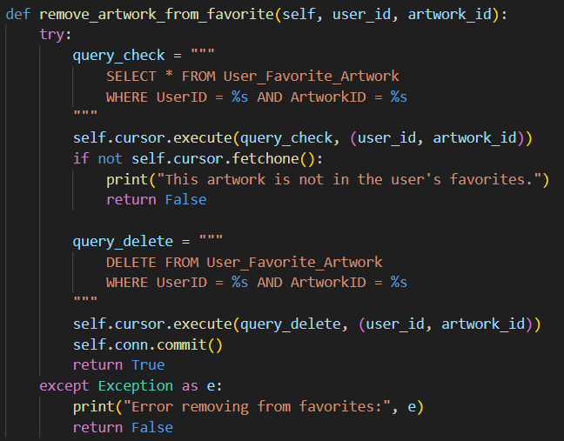
REMOVE ARTWORK FROM FAVORITES
Removes a favorite record.
Uses UserID and ArtworkID.
Runs SQL DELETE in junction table.
Confirms removal.

Slide 10
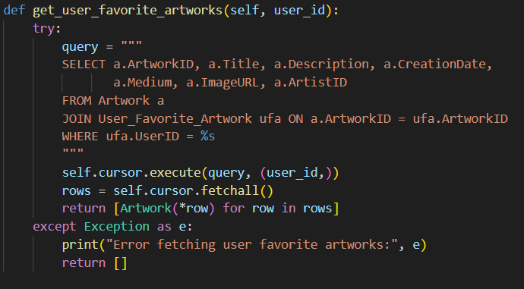
GET USER FAVORITE ARTWORKS
Lists all favorites for a user.
Uses SQL JOIN.
Fetches full artwork details.
Returns results as list.

Slide 11
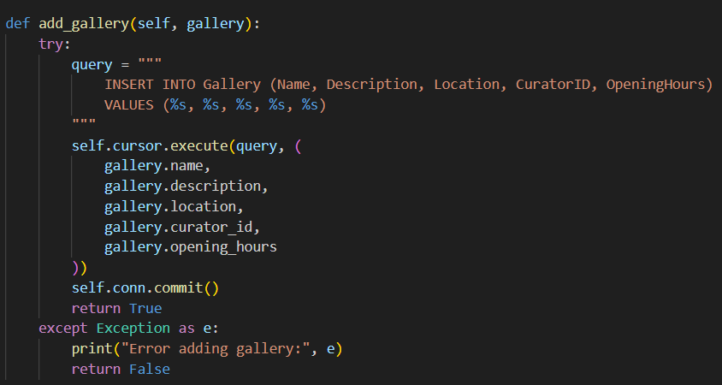
ADD GALLERY FUNCTION
Adds new gallery to database.
Includes name, description, location, curator, hours.
Runs SQL INSERT.
Confirms addition.

Slide 12
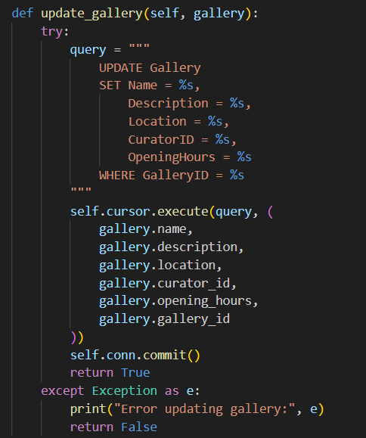
UPDATE GALLERY
Edits gallery details.
Uses Gallery ID.
Runs SQL UPDATE.
Confirms successful update.

Slide 13
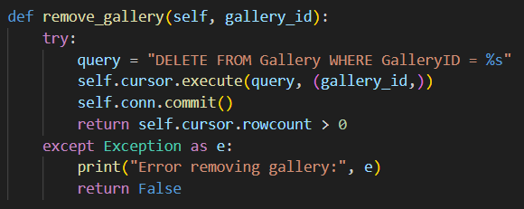
REMOVE GALLERY FUNCTION
Deletes gallery by ID.
Runs SQL DELETE.
Cleans up records.
Confirms removal.

Slide 14
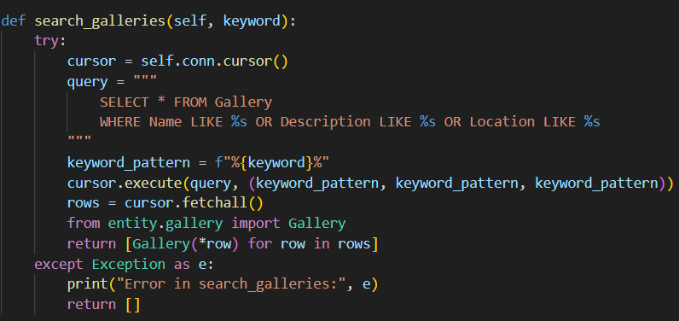
SEARCH GALLERIES FUNCTION
Allows keyword search.
Matches name or description.
Uses SQL LIKE operator.
Returns matching galleries.

Slide 15


EXCEPTION HANDLING
Custom exception classes for clean error handling.
ArtworkNotFoundException when artwork ID is invalid.
UserNotFoundException for invalid user ID.
Prevents program crashes.
Shows clear, user-friendly error messages.

Slide 16
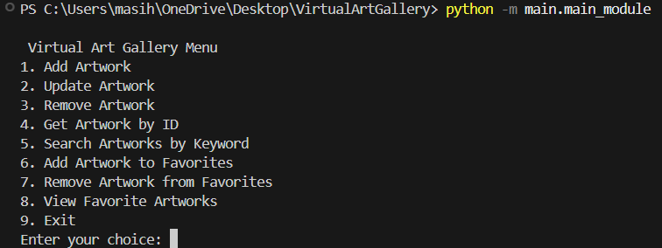
COMMAND-LINE MENU

Slide 17
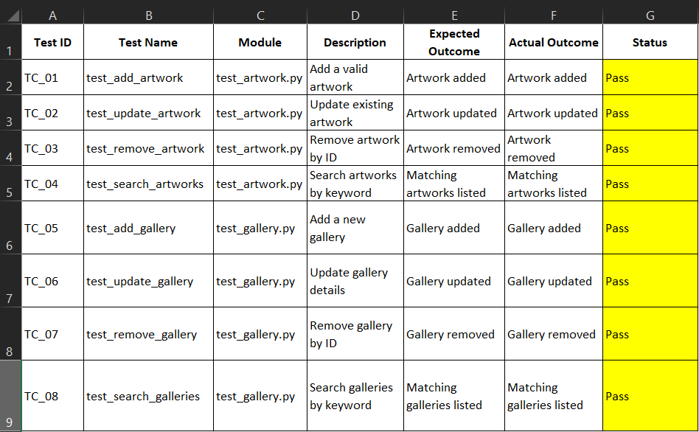
TEST CASE EXECUTION REPORT

Slide 18
CONCLUSION
Complete backend system for a virtual art gallery.
Supports adding, updating, deleting, and searching artworks and galleries.
Manages user accounts and favorites.
Uses clean code with DAO pattern.
Connects to MySQL database with proper schema.
Includes error handling with custom exceptions.
Tested using Python’s unittest module.
Easy to use through a command-line interface.

